Slide 1

Connect students to scholarships and information about financial aid
Slides you can show in class

Slide 2

Teacher Resource:
Ways to Use
About BigFuture Scholarship Search
The database includes over 24,000 scholarships that award $4 billion every year.
Students can can get matched with scholarships based on their background, future plans, and past achievements.
All scholarship details on BigFuture® are provided by the National Scholarship Providers Association.
Take 2 minutes: Show a slide per day as your students are walking into class.
Share in your online classroom: Post the information for students to explore on their own.
Display outside your door: Give all students access to the information by sharing outside your classroom.
Encourage students to match with additional scholarships at bigfuture.org/scholarship-search.

Slide 3
About the Slides
5 slides on available scholarships
The slides provide information about scholarships that are open now (September 2023) or opening soon.
Information on deadlines, requirements, and potential winnings are included, plus a QR code to learn more about the scholarship.
Students can stay organized by adding scholarships to their scholarship list on BigFuture.
5 slides with a daily tip
Each slide offers a tip of the day, plus a QR code for students to learn more about the topic.

Slide 4
Scholarship slides to share with students

Slide 5




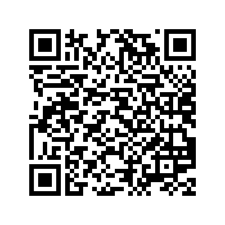
Mensa Foundation Trustee’s Scholarship
Open now
You could win
$15,000
Apply by
January 15, 2024
Requirements
Get more info
Must be enrolled in a degree program during the academic year after the application date.
Essay must be no longer than 550 words.
Get matched with scholarships
bigfuture.org/scholarship-search

Slide 6
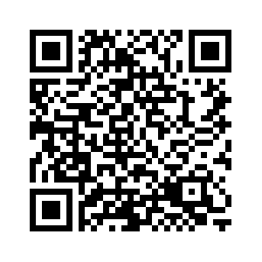
Courage To Grow Scholarship
Open now
You could win
$500
Apply by
December 31, 2023
Requirements
Get more info
High school junior or senior
Minimum 2.5 GPA
U.S. citizen
250-word essay
Get matched with scholarships
bigfuture.org/scholarship-search

Slide 7
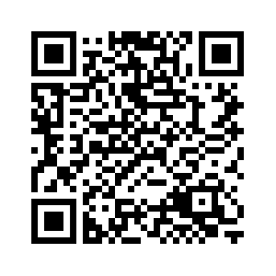
BigFuture Scholarships
Open now
You could win
$500 or $40,000
Monthly drawings
Requirements
Get more info
Class of 2024 or 2025
Complete tasks to plan for life after high school on BigFuture
Two $40,000 winners every month and hundreds of $500 winners
*The class of 2026 is eligible starting Dec. 2023
Get matched with scholarships
bigfuture.org/scholarship-search

Slide 8
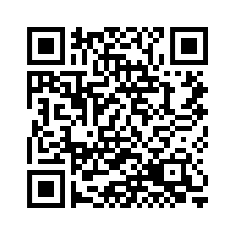
BBQ Galore Scholarship
If you’re interested, the application opens in October
You could win
$1,000
Apply by
June 2024
Requirements
Get more info
3.0 GPA
U.S. citizen
Submit an essay
Get matched with scholarships
bigfuture.org/scholarship-search

Slide 9
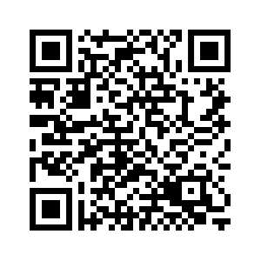
Davidson Fellows Scholarship
If you’re interested, the application opens in November
You could win
$50,000
Apply by
February 2024
Requirements
Get more info
Under 18 years old
U.S. citizen
Complete a significant piece of work in the STEM field, literature, music, philosophy or “outside the box.”
Identify people to nominate you.
Get matched with scholarships
bigfuture.org/scholarship-search

Slide 10
Tips to share with students about financial aid and scholarships

Slide 11

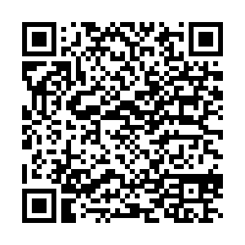
Paying for Your Education:
Tip of the Day
Take the time to understand what’s out there.
Check out this 3-minute video about financial aid, scholarships, and the costs of college.

Slide 12

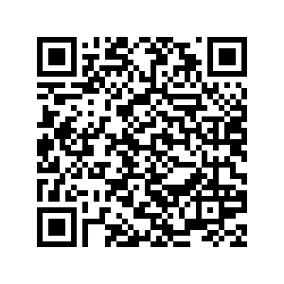
Paying for Your Education:
Tip of the Day
Debunk myths about the costs of education.
Once students understand what college really costs, they often discover that higher education is within their reach.
Read this article to learn more:

Slide 13

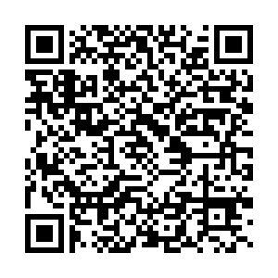
Paying for Your Education:
Tip of the Day
There are options for undocumented students.
Check out these FAQs to learn more:

Slide 14

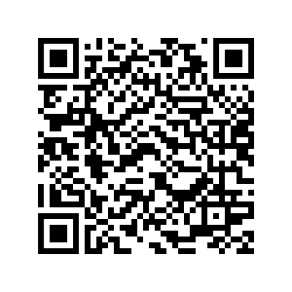
Paying for Your Education:
Tip of the Day
Watch this 2-minute video with the most frequently asked questions about financial aid.

Slide 15

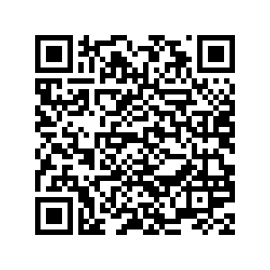
Paying for Your Education:
Tip of the Day
Books, supplies, and more are everyday costs to consider when exploring your education options.
Read this article:

